Slide 1
Breast Cancer Prediction
IST 718 Final Project Report
Group 1
Mike DeMaria, Lu Guo, Haotian Shen, Casey Walsh

Slide 2
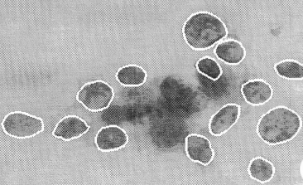
Introduction
When a tumor is detected, it needs to be assessed if it’s benign or malignant.
Nowadays, Machine Learning has been widely used to help detect tumors.
We want to know that given the output of the image analysis, can we predict malignancy?

Slide 3
Data Exploration
We obtain breast cancer data from Kaggle: https://www.kaggle.com/datasets/uciml/breast-cancer-wisconsin-data/data
569 rows
32 columns:
• patient ID
• 1 binary output variable (benign or malignant)
• 30 numerical variables of cancer cells
10 categories: radius, texture, perimeter, area, smoothness, compactness, concavity, concave points, symmetry, and fractal dimension.
3 values for each feature: the mean, the standard error, and the mean of the three worst (largest) cells.

Slide 4
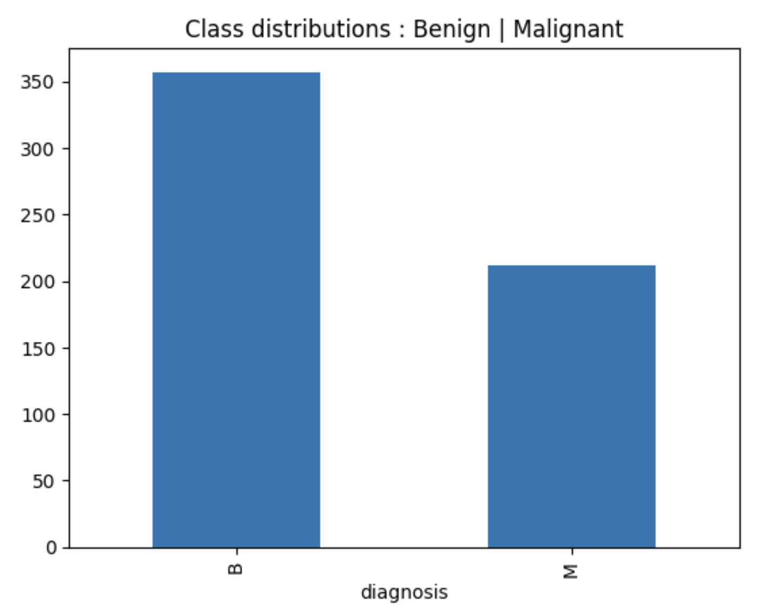
Data Exploration

Slide 5
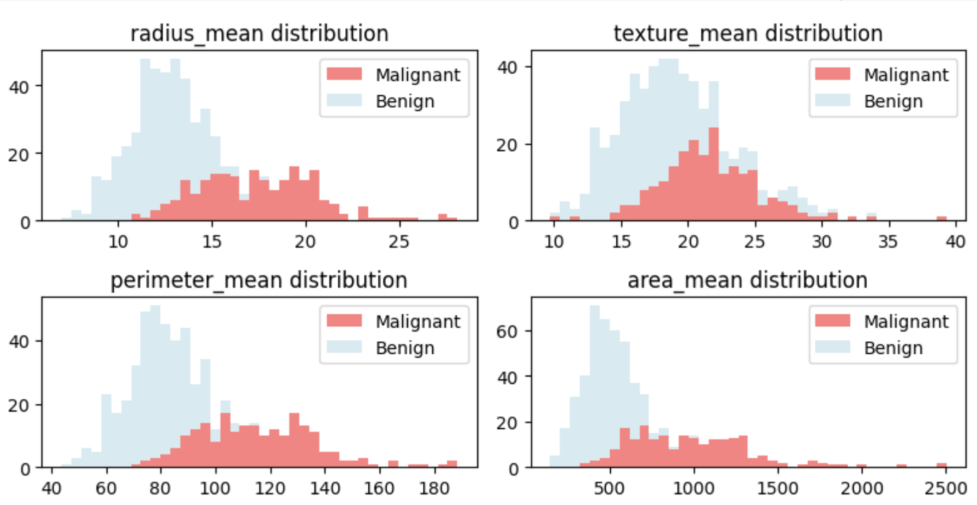
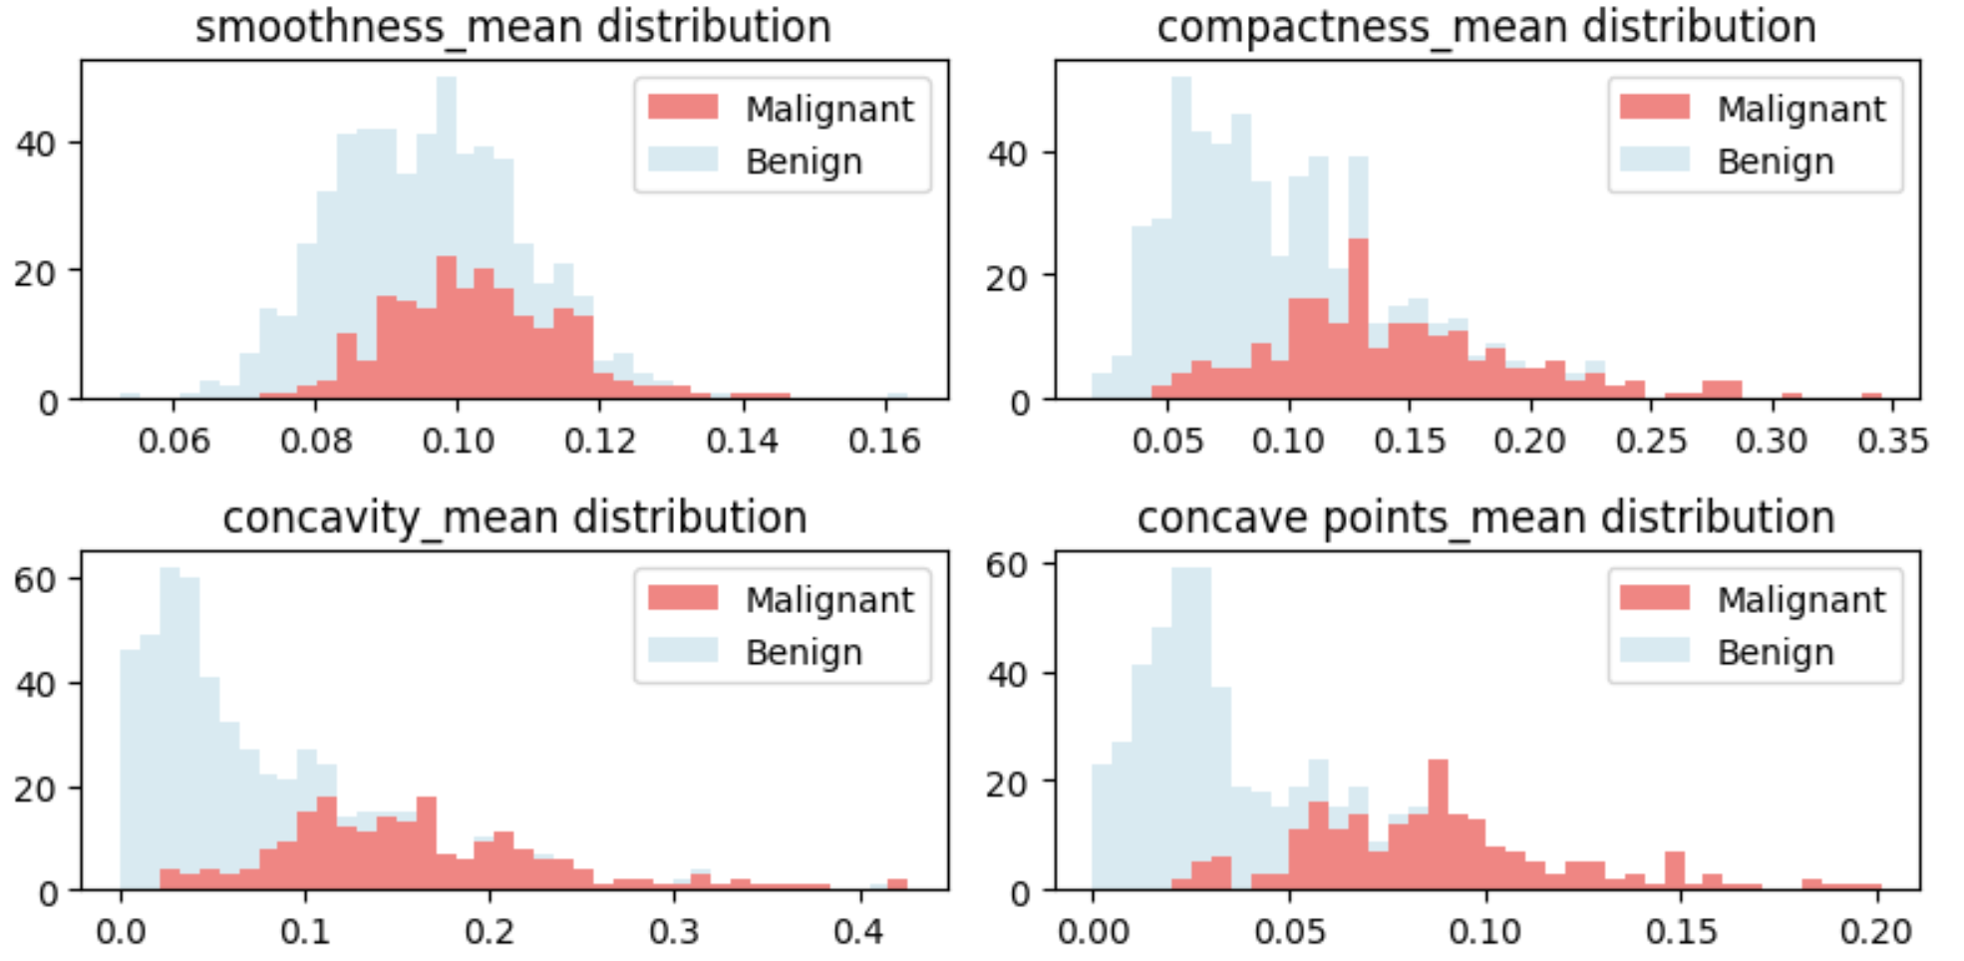
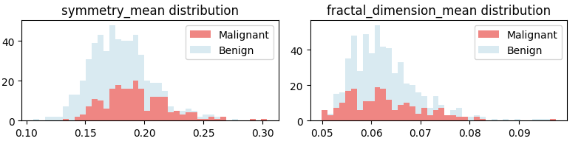
Data Exploration

Slide 6
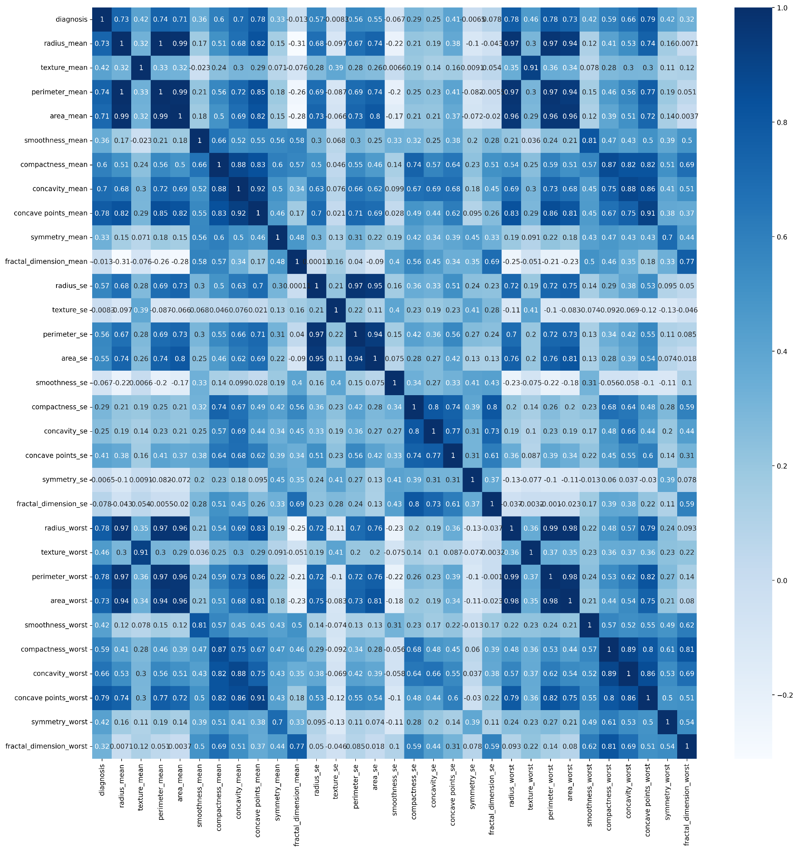
The below columns have very low correlation to diagnosis:
fractal_dimension_mean,
texture_se,
smoothness_se,
symmetry_se,
fractal_dimension_se.
When doing feature engineering, maybe we can try to remove these columns.

Slide 7
Original Model
Decision Tree Model
Used 3 of the thirty available features
Mean Texture
Worst Area
Worst Smoothness
Small subsets chosen for compute speed
Original Model achieved 97% accuracy
Attempt to replicate this model achieved 92% accuracy
Depth 6
28 nodes

Slide 8
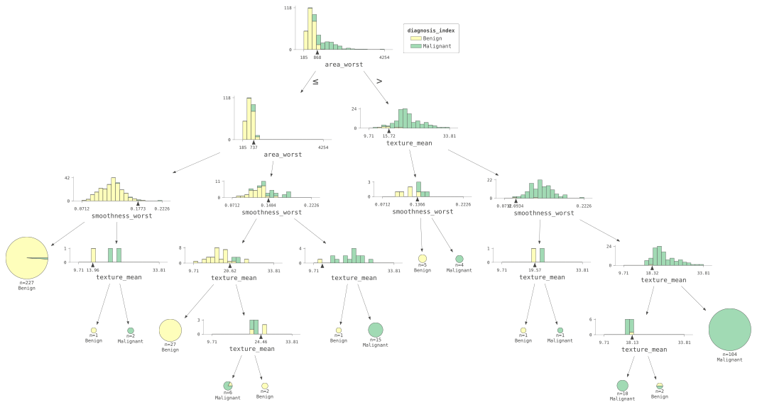

Slide 9
Recreating the Original Model
Decision Tree Model trained with the same three features
Trained in under 10 seconds
Initial accuracy of 92%
Retrained model with three features and hyperparameter grid search
Trained 120 models in approximately 10 minutes
Best model parameters:
Depth 5
15 nodes
Final accuracy of 96%

Slide 10
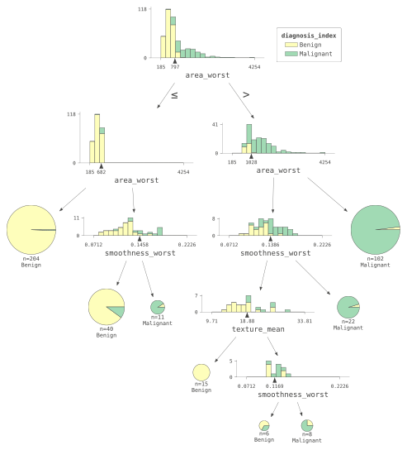

Slide 11
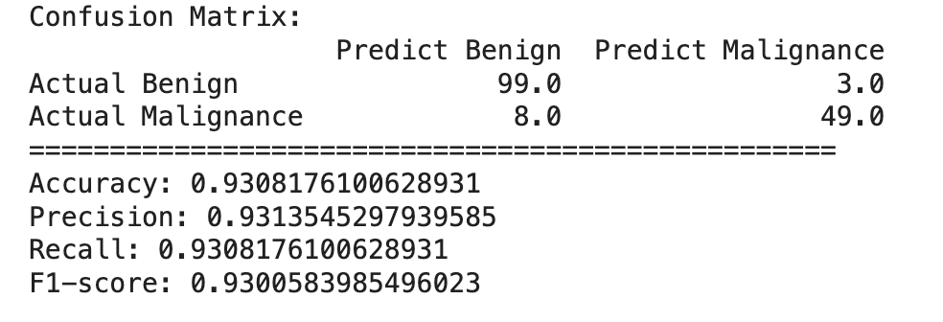
Neural Network
32
16
2
batches
Select all mean features

Slide 12
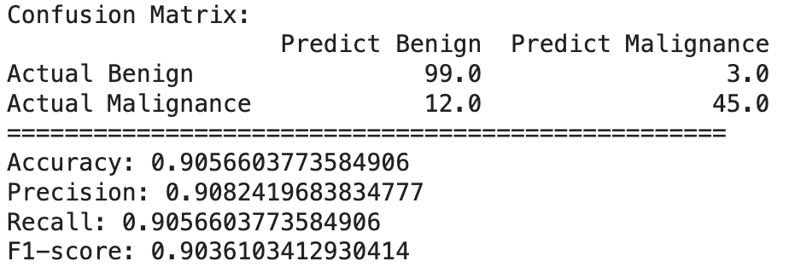
Neural Network
32
16
2
batches
Select all standard error features

Slide 13
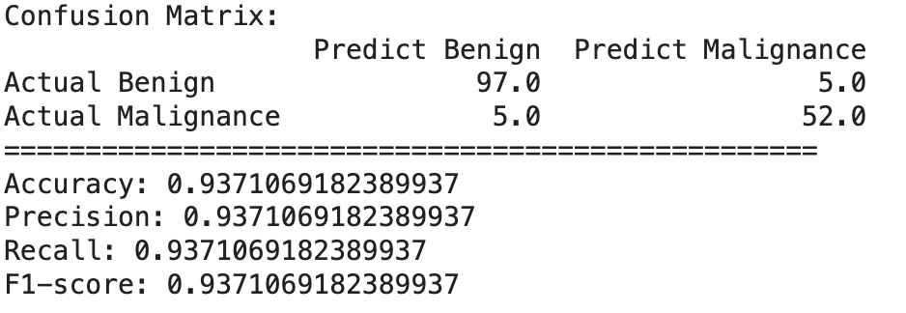
Neural Network
32
16
2
batches
Select all worst features

Slide 14
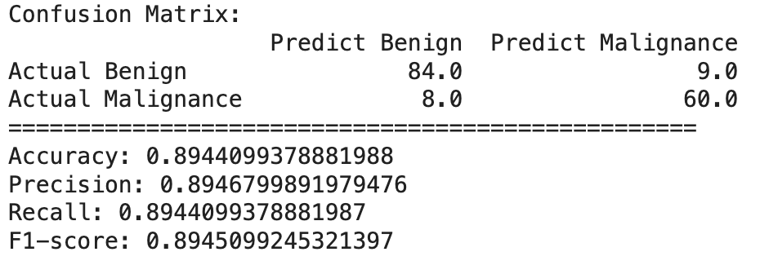
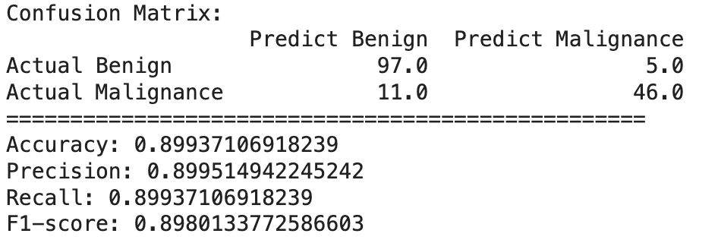
Neural Network
32
16
2
64
32
16
2
batches
batches
Select all features

Slide 15
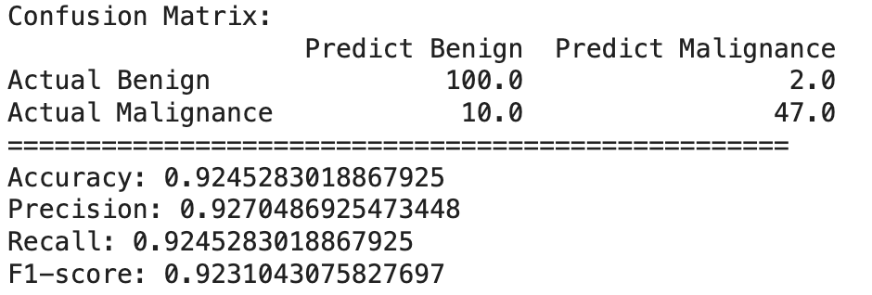
Neural Network
64
32
16
2
batches
Drop 'fractal_dimension_mean', 'texture_se', 'smoothness_se', 'symmetry_se', 'fractal_dimension_se'

Slide 16
Neural Network
 | accuracy | precision | recall | f1-score
All mean features | 0.9308 | 0.9314 | 0.9308 | 0.9301
All standard error features | 0.9057 | 0.9082 | 0.9057 | 0.9036
All worst features | 0.9371 | 0.9371 | 0.9371 | 0.9371
All features | 0.8944 | 0.8947 | 0.8944 | 0.8945
All features(large) | 0.8994 | 0.8995 | 0.8994 | 0.8980
All features+Drop(large) | 0.9245 | 0.9270 | 0.9245 | 0.9231

Slide 17
Additional Models
Algorithm | Data Used | AUC | Runtime (seconds)
Logistic Regression | “Worst” Cells | 95.5% | 2.1
Random Forest | All | 97.9% | 6.2
Logistic Regression (Increased iterations) | Mean/Std Dev | 98.3% | 4.8
GBT | All | 98.9% | 11.8
Logistic Regression | Mean/Std Dev | 99.1% | 2.14
LinearSVC | All | 99.6% | 28.3
Logistic Regression | All | 99.7% | 4.2

Slide 18
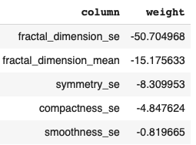
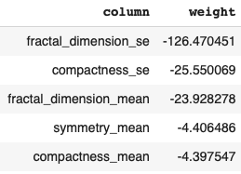
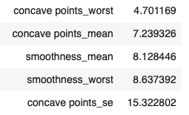
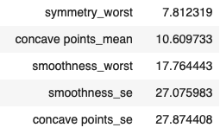
Best Models Bottom/Top Coefficients
Logistic Regression
LinearSVC

Slide 19
Best Models Quality
 | Linear Regression | LinearSVC
Runtime | 4.2 seconds | 28.3 seconds
AUC | 99.7% | 99.6%
Accuracy | 98% | 98%
Precision | 96% | 98%
Recall | 100% | 99%
F-measure | 98% | 99%
False Positives | 4 | 2
False Negatives | 0 | 1

Slide 20
Thanks!

